Slide 1
UNDP Ukraine
Environment and Energy
Portfolio Overview
Olena Maslyukivska-Samberg
Programme Analyst (Environment)
October 10, 2017

Slide 2
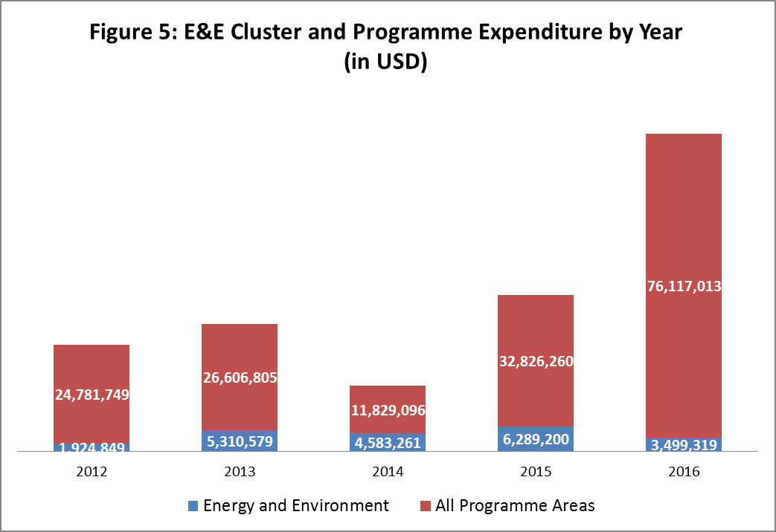
Environmental and CO Programme Expenditure by Year, USD

Slide 3
Project Financing by Donor (total, USD)

Slide 4
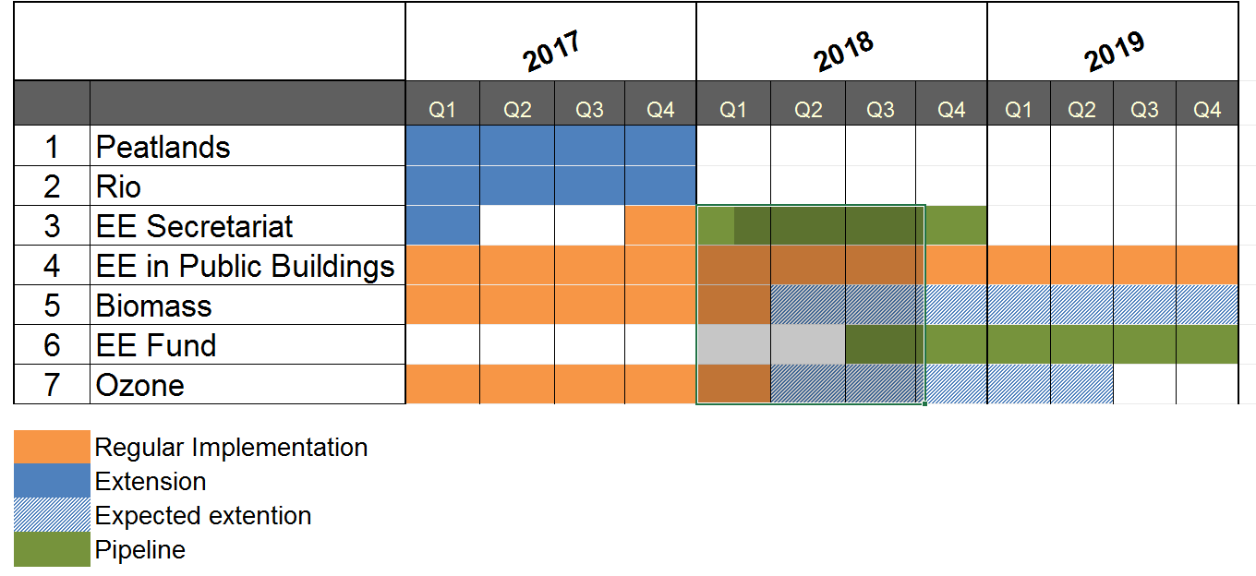
Projects Timelines

Slide 5
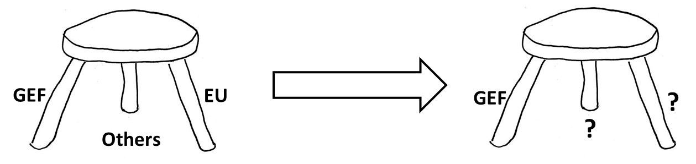
The “three legs” of Environmental portfolio

Slide 6
Level of Engagement of UNDP Projects
National Level
Energy Efficiency Secretariat
Environmental Monitoring of Black Sea
Ozone
Rio Conventions
Peatlands
Energy Efficiency in Public Buildings
Biomass Commercialization
Community Based Approach
Small Grants Program
Local Level

Slide 7
Current position in Energy Efficiency, Energy Security and Renewable Energy
Advisory services to the GoU
Residents
Home-Owners Associations
Financial support mechanism
Policy level
Local level
Market creation mechanisms
Private business
ESCO
Municipalities
Energy management systems

Slide 8
Portfolio Development
Energy Security
Climate Change
Biodiversity
Recovery of Chernobyl Area
Water Management
Waste Management
Environmental Governance
Decentralization
Energy Security
SDGs
GoU Mid-Term Priority Areas

Slide 9
Ideas for portfolio growth 1/2
Thematic areas | Rationale | Donors
Green and Clean Energy | Energy Strategy 2035 adopted Law on the Energy Efficiency Fund Substantial work to be done, for example, on secondary legislation and implementation Leadership is required in the development of renewables Microgrids Prosumers - a consumer who becomes involved with designing or customizing products for their own needs | USA/Norway GEF
Climate change adaptation and mitigation | Ukraine lacks the Climate Change Adaptation Strategy There is lack of leadership for the recently developed draft strategy on the Low carbon development strategy Urban planning Dealing with vulnerability to droughts and floods Building resilience to natural disasters Addressing increasing levels of heat stress | GEF/EU
Green Cities | Sustainable mobility, sustainable energy and sustainable waste and water | GEF

Slide 10
Ideas for portfolio growth 2/2
Thematic areas | Rationale | Donors
Waste management at the national and local levels | A significant number of municipalities have no waste management system The new Waste Management Strategy is about to be adopted Problem with disposing Waste Electrical & Electronic Equipment (WEEE) Investor for a WEEE disposal facility System of WEEE collection System of payment for disposal | EU/Sweden GEF
Municipal and ecosystem services management by amalgamated communities | Impoverished communities do not care about the environment Newly amalgamated communities have more funds Newly amalgamated communities lack skills in managing communal services (waste management, water and sanitation) fragile ecosystems: natural reserves, degraded land, polluted with plastics rivers ecosystem services: forest belts, water levels | Sweden/EU
Environmental monitoring of the conflict-affected area in eastern Ukraine | Alignment of the current results Setting priorities Use of precautionary principle Mine flooding – water and soils contamination Sewage treatment – water contamination Fully aligned with UNDP’s area-based programme for the Donetsk and Luhansk Oblasts | Canada/Ukrainian based Embassies

Slide 11
Organigramme
Olena Maslyukivska-Samberg
Programme Analyst
Alla Tynkevych
Programme associate
Vasyl Tolkachov
Project Manager
Peatlands
Volodymyr Lyashchenko
Project Manager
Biomass
Sergii Varga
Project Manager
EE in Public Buildings
Kateryna Korvin-Piotrovska
Project Manager
Rio+SDG
No Project Manager
Ozone
Yuliya Berezhnaya
Associate
Peatlands
Nina Pashchenko
Assistant
Ozone
Yuliia Decheva
Assistant
Biomass
Iuvgen Spivakovskyi
Associate
EE in Public Buildings
Iryna Tarnavska UNV
Communication and Outreach
Polina Nezdiikovska, UNV, M&E
Svitlana Nigorodova
Small Grants Program
Programme
Valentyna Kirichenko Assistant SGP
Yaroslav Demchenkov
Energy Security and Renewable Energy
Funding
GEF
EU
UNDP
SlovakAid

