Slide 1
Co-financing
REQUIREMENTS FOR UNDP-SUPPORTED, GEF-FUNDED PROJECTS

Slide 2
WHAT IS CO-FINANCING?
“Co-financing for GEF-financed projects is defined as resources that are additional to the GEF grant and that are provided by the GEF Partner Agency itself and/or by other non-GEF sources that support the implementation of the GEF-financed project and the achievement of its objectives”
(p.1, GEF Co-Financing Policy available at http://www.thegef.org/sites/default/files/documents/Co-financing_Policy-2014_0.pdf )

Slide 3
What are the sources?
Bilateral Aid Agency(ies), Foundation, GEF Partner Agency, Local Government, National Government, Civil Society Organization, Other Multi-Lateral Agency(ies), Private Sector, Other
What are the types?
Grant, Soft Loan, Hard Loan, Guarantee, In-Kind, Other

Slide 4
Who is responsible?
Project manager together with the project team
Portfolio Manager
CO UNDP
WHEN do we report about co-financing?
In both midterm and final evaluations.

Slide 5
How to calculate the co-financing ratio?
The co-financing ratio is determined by the total of non-GEF resources provided for a project compared to GEF grant resources, including the GEF Project Grant and Project Preparation Grants. Enabling activities, which do not require co-financing, will not be counted in the overall portfolio co-financing ratio.
p.3, GEF Co-Financing Policy available at http://www.thegef.org/sites/default/files/documents/Co-financing_Policy-2014_0.pdf

Slide 6
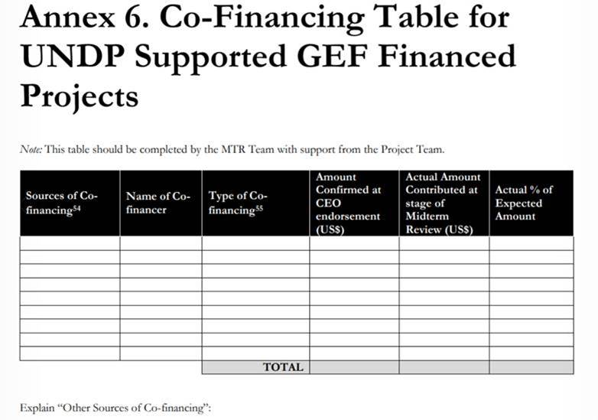
CO-financing in midterm review
Source: page 48 of GUIDANCE FOR CONDUCTING MIDTERM REVIEWS OF UNDP-SUPPORTED, GEF-FINANCED PROJECTS
available at http://web.undp.org/evaluation/documents/guidance/GEF/mid-term/Guidance_Midterm%20Review%20_EN_2014.pdf

Slide 7
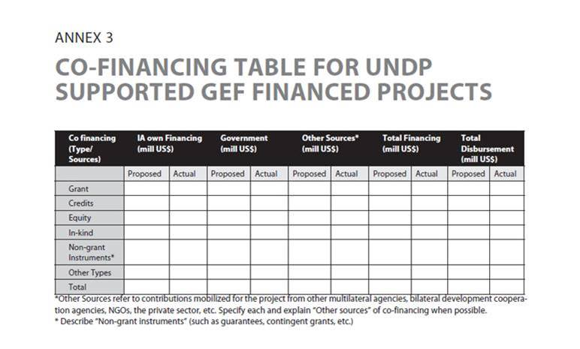
Co-financing in final evaluation
Source: page 39 of GUIDANCE FOR CONDUCTING TERMINAL EVALUATIONS OF UNDP-SUPPORTED, GEF-FINANCED PROJECTS available at http://web.undp.org/evaluation/documents/guidance/GEF/UNDP-GEF-TE-Guide.pdf

Slide 8
THINGS TO THINK/WRITE ABOUT
Is co-financing being used strategically to help the objectives of the project?
Is the Project Team meeting with all co-financing partners regularly in order to align financing priorities and annual work plans?
Do you remember to report yearly?

